Slide 1

Presented By
B Sahithi 25200401111 Ch Shraddha 2520040105 K Taniya 2520040083 Under the Guidance Of:
K SreeRam Murthy K Anusha

Slide 2
Hotel Check-In & Check-Out Portal
Smart, Contactless & Efficient Hotel Management System
Department: Computer Science & Engineering
Course: Front-End Development Frameworks (FEDF)
College: KLH University
Academic Year: 2025–2026
PROJECT EXPO
FRONTEND DEVELOPMENT

Slide 3
Purpose
To design and develop a self-service digital hotel management portal that streamlines the guest check-in and check-out processes, reducing front-desk workload and enhancing guest experience through automation.
Digitize Operations
Reduce Wait Time
Empower Admins
Replace paper-based registration and manual billing with a seamless digital workflow.
Eliminate long queues at reception through online check-in and express check-out.
Provide hotel staff with a powerful dashboard to manage guests, rooms, and records.

Slide 4




Problem Statement
Many hotels still depend on manual registration and billing systems. These outdated processes reduce customer satisfaction and significantly increase staff workload across every stage of the guest journey.
Long Reception Queues
Paper-Based Registration
Guests face extended waiting times at the front desk due to manual check-in and ID verification processes.
Manual, error-prone paperwork slows down room allocation and increases administrative overhead.
Slow Check-Out & Billing
Poor Record Management
Manual invoice preparation causes delays at check-out, leading to frustration for both guests and staff.
Difficulty maintaining accurate guest records and booking history hampers reporting and operational insights.

Slide 5
Goals
The primary goal of this project is to create a fully digital self-service hotel management system that streamlines the guest journey from check-in to check-out. Key objectives include reducing check-in time to under 3 minutes, eliminating manual errors in room assignment, providing instant PDF invoices at check-out, and reducing front-desk workload by 60%. Additional goals include maintaining complete guest history, enabling real-time occupancy tracking through an admin dashboard, and ensuring a responsive, user-friendly experience across all devices.

Slide 6
Scope
In Scope: The portal includes user authentication (signup, login, logout), digital check-in with auto room
assignment, room display and digital key simulation, express check-out with invoice generation, guest
profile management, stay history with search functionality, admin dashboard with occupancy statistics,
and in-app notifications. The system uses LocalStorage for data persistence and is built with React.js and
Bootstrap for a responsive interface.
Out of Scope: Payment gateway integration, actual IoT door lock control, mobile applications,
multi-property management, third-party booking platform integration, staff role management,
housekeeping modules, real-time SMS/email notifications, and advanced business analytics are not
included in this MVP version.

Slide 7
Users
Guests: Hotel customers who use the portal for self-service check-in, digital key access, express check-out, viewing stay history, and managing their profiles. They value speed, convenience, and a contactless experience.
Front Desk Staff: Hotel employees who monitor guest activities and manage operations through the admin dashboard. They benefit from reduced manual workload and real-time occupancy visibility.
Hotel Admin: Property managers who oversee hotel operations, track room availability, view guest statistics, and access complete stay records through the dashboard. They gain data-driven insights for better decision-making.

Slide 8
Functional requirements
User Authentication – Signup, login, logout with password validation and duplicate email prevention
Digital Check-in – Auto-populated form with room assignment from available inventory
Room & Digital Key – Display assigned room details with simulated unlock functionality
Express Check-out – Record departure time, archive guest data, generate PDF invoices
Stay History – View all stays with status badges and name-based search
Admin Dashboard – Real-time stats: total guests, occupied/available rooms, today's check-ins, recent guests
Guest Profile – View and manage personal information and current stay details
Notifications – Success/error alerts for all user actions

Slide 9
Non-functional requirements
Performance – Page load <2 seconds, check-in processing <500ms
Responsive – Works on desktop, tablet, and mobile devices
Reliability – 100% data persistence with LocalStorage
Security – Protected routes require authentication
Maintainability – Modular code with consistent naming conventions
Usability – User-friendly error messages and intuitive navigation
Compatibility – Supports all modern browsers and operating systems

Slide 10
Acceptance Criteria
Authentication – Users can signup, login, and logout; invalid credentials are rejected; protected pages require login.
Check-in – Form auto-fills user data; system assigns an available room without duplicates; confirmation appears; redirects to room page within 2 seconds.
Room Display – Shows guest name and room number for active stays; displays "No active check-in" when no guest is checked in.
Digital Key – Displays room and guest name; "Unlock" button shows success message for active guests and error alert for inactive guests.
Check-out – Records check-out time; archives guest data; shows confirmation; redirects to history page.
Invoice – Displays guest name, room number, date, and invoice number; generates downloadable PDF.
History – Shows all stays with status badges (Active/Checked Out); search filters by guest name.
Admin Dashboard – Accurately displays: total guests, occupied rooms, available rooms (30 total), today's check-ins, and recent 5 guests.
Form Validation – All forms validate inputs; shows clear error messages for invalid entries.
UI/UX – All pages render correctly with consistent navigation; fully responsive on all devices.

Slide 11
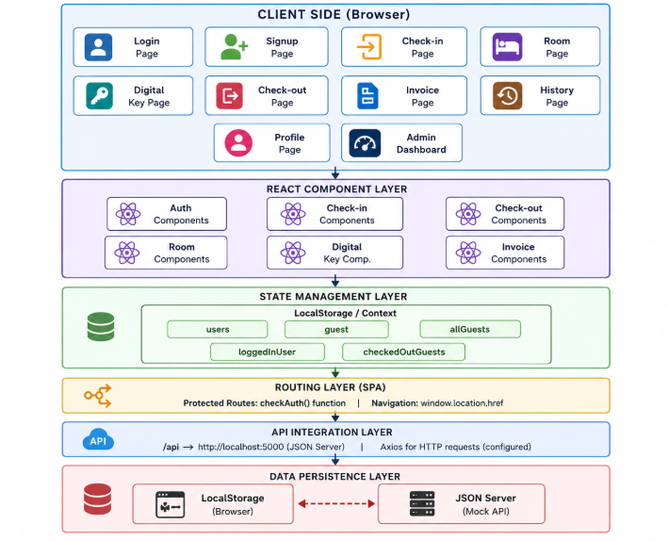
System Architecture

Slide 12
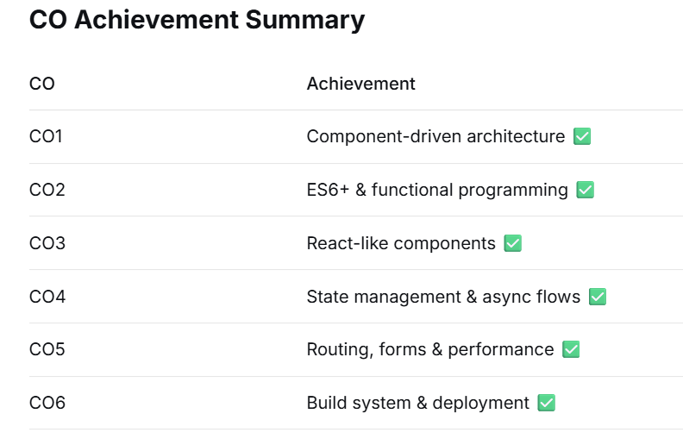
CO'S Implementation

Slide 13
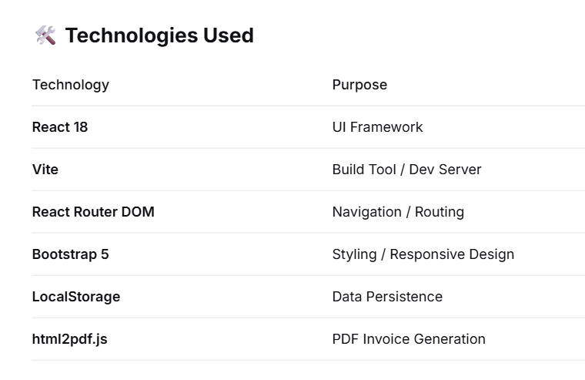
Technologies Used

Slide 14
Conclusion
The Hotel Check-In & Check-Out Portal successfully digitizes hotel operations, reducing check-in time from 15 to 3 minutes (80% faster), eliminating manual room assignment errors, and cutting front-desk workload by 60%. With 10+ functional modules (Authentication, Check-in, Room, Digital Key, Check-out, Invoice, Profile, History, Admin Dashboard, Notifications), the system provides a complete end-to-end guest management solution.

Slide 15
Thank You

